Slide 1
BE or DO ?
6C

Slide 2
What | is | your name?
What day | is | today?
What | is | your favourite day of the week?
Who | is | her favourite singer?

Slide 3
What | is | this?
What | are | those?
What | is | your email address?
What lesson | is | this?

Slide 4
Where | is | your surname from?
Where | are | my glasses?
When | is | the English class?
What time | is | our English class?

Slide 5
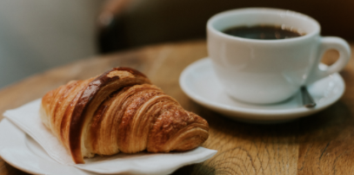
How | are | you ?
How old | are | you ?
How much | is | a coffee and a croissant?

Slide 6
Is | your mother | at home?
Is | the series | interesting?
Are | these series | interesting?
Is | your house | big?

Slide 7
Questions with WHAT …BE…LIKE
What | is | the weather | like today ?
What | is | your best friend | like?
What | are | the people/the streets/the houses | like in Mendoza?
What | is | autumn | like in Mendoza?

Slide 8
What | do | you | do?
What food | do | you | like?
What kind of books | do | you | read?
What TV programmes | do | you | watch?

Slide 9
How | do | you | spell | your name ?
How many brothers and sisters | do | you | have | ?
How | do | you | do | ?

Slide 10
Now and around now – Present Continuous
What | are | you | doing | right now?
What exams | are | you | taking | these days?
What | is | Peter | wearing | today?
What kind of music | are | they | listening to | at the moment?
What subjects | are | they | attending | this semester?

Slide 11
Now and around now. Present Continuous
Are | you | reading | a book right now?
Is | Maria | doing | housework today?
Are | the students | sitting | for an exam right now?
Are | they | going | home now?

Slide 12
Are you here? Yes, I am. No, I’m not.
Am I here?
Are they here?
Is she here?
Is he here?
Is it here?
The students, your mother, my husband, the people in the office
The interesting books, the musicians, Autumn, the museum,
The computers, my neighbour, your neighbours, the houses, the photos on your cell phone, the members of your family.
BE: Yes/No questions

Slide 13
Do you read a lot? Yes, I do. No, I don’t.
Do I read a lot?
Do they read a lot?
Does she read?
Does he read?
Does it work? Does it have a garden?
The students, your mother, my husband, the people in the office, the musicians, the museum, The computers, my neighbour, your neighbours, the houses, your cell phone, the members of your family, etc.
DO: Yes/No questions

Slide 14
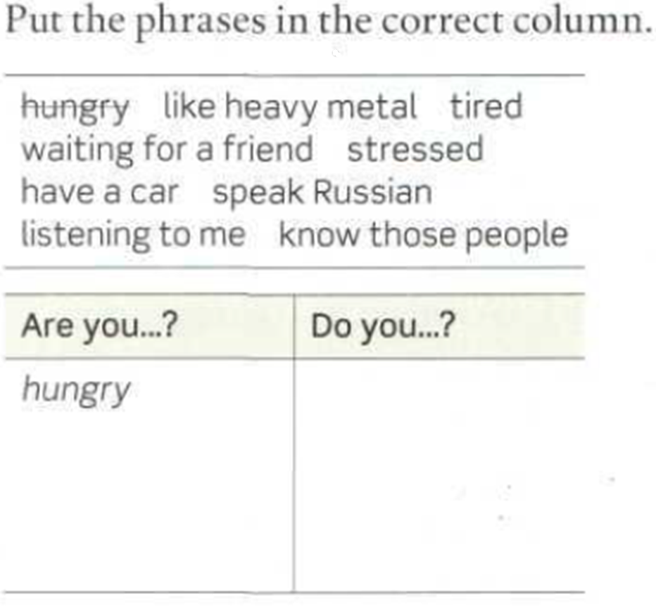




Slide 15
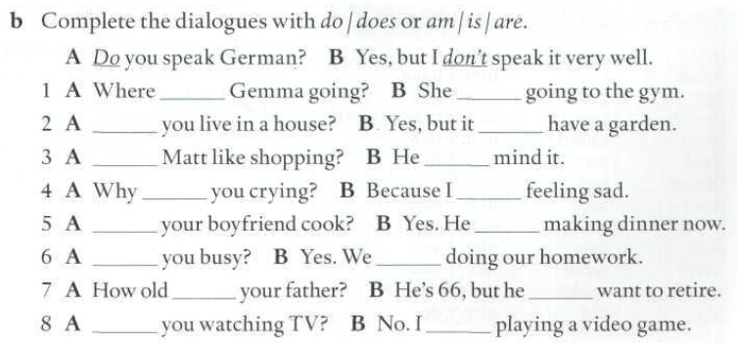
is
is
Do
doesn’t
Does
doesn´t
are
am
Does
is
Are
are
is
doesn’t
Are
am

